Slide 1
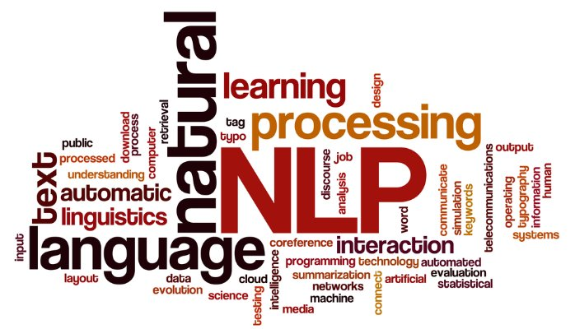
NLP Tasks and Methods
Dr. Ignatius Ezeani
Friday, 12 March 2021
Notes:
Hello every one, Welcome to the 2nd lecture from the NLP part of this module SCC.413.
In this lecture, we will

Slide 2

Lecture Outline
This lecture is structured in three parts:
Part 1:
Why NLP? What is it?
Why is it hard?
Part 2
Some common NLP Problems
Approaches to solving them
Part 3
Machine Learning for NLP
Extracting feature from text

Slide 3

Intended Learning Outcomes
At the end of this lecture, you should be able to
explain what NLP is and why it is hard
discuss some common NLP problems and approaches to solving them
explain how machine learning methods are used for NLP problems
discuss methods feature extraction from texts

Slide 4
What is NLP and why do we need it?

Slide 5
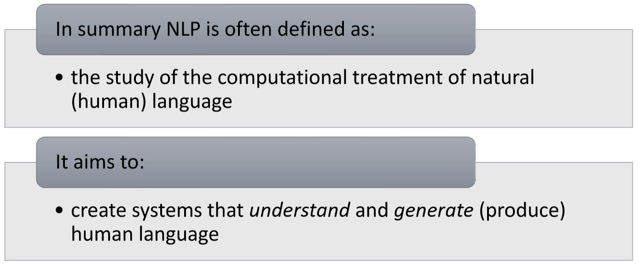
What is NLP?

Slide 6
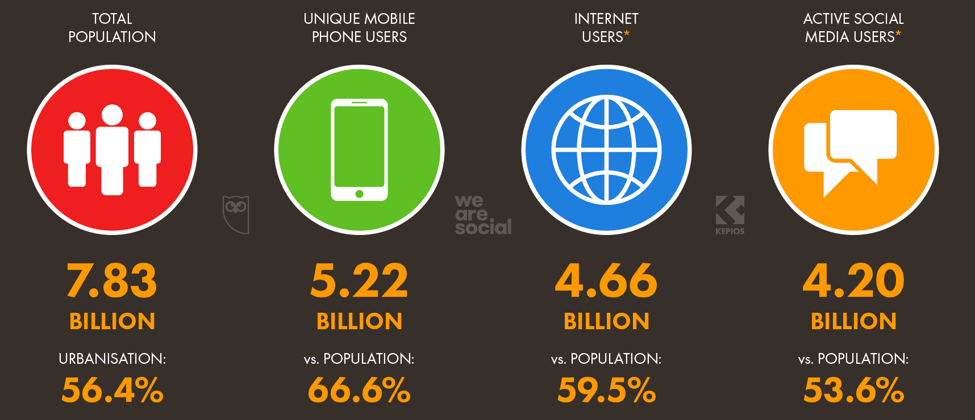
Who is on the internet?
By the end of Jan 2021
7.83bn people on earth
5.22bn mobile phone were active
4.91bn by end of 2017
4.66bn people were online
3.8bn by end of 2017
4.20bn social media users
https://www.nodegraph.se/how-much-data-is-on-the-internet/

Slide 7
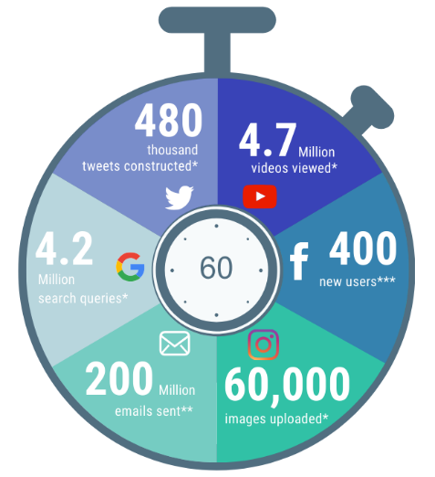
What happens every minute?
Every 60 seconds… 2020 vs 2017
 | 2020 | 2017
Emails sent | 200 million | 150 million
Google searches | 4.2 million | 3.8 million
Tweets sent | 480,000 | 448,800
Instagram images | 60,000 | 66,000
YouTube video | 4.7 million | 4.4 million
Facebook new users | 400 | 360
https://www.nodegraph.se/how-much-data-is-on-the-internet/

Slide 8

How much data has the internet?
2.7 Zb in 2017
4.4 Zb by end of 2019
44 Zettabytes (Zb) in 2020
175 Zb by end of 2025
A gigabyte is 1,024 megabytes
A terabyte is 1,024 gigabytes
A petabyte is 1,024 terabytes
An exabyte is 1,024 petabytes
A zettabyte is 1,024 exabytes
Putting that in context
1Zb = 1,024 exabytes,
1Zb = 1,048,576 pb,
1Zb = 1,073,741,824 tb,
1Zb = 1,099,511,627,776 gb,
1Zb = 1,125,899,910,000,000 mb!

Slide 9

How much data has the internet?
175 Zettabytes!
If on DVDs, the stack of DVDs would be long enough to circle the Earth 222 times!
If download at the average current internet connection speed, it would take you 1.8 billion years to download!

Slide 10
Why Natural Language Processing
Our devices are now part of our lives and we often cannot function without them.
We generate tonnes of human language data everyday and we desire to know what the data is telling us, sometimes in real-time.
We need tools and techniques to process the enormous amount of data on the internet and communicate outputs to us in human language
That’s why we need natural language processing techniques to create these tools

Slide 11
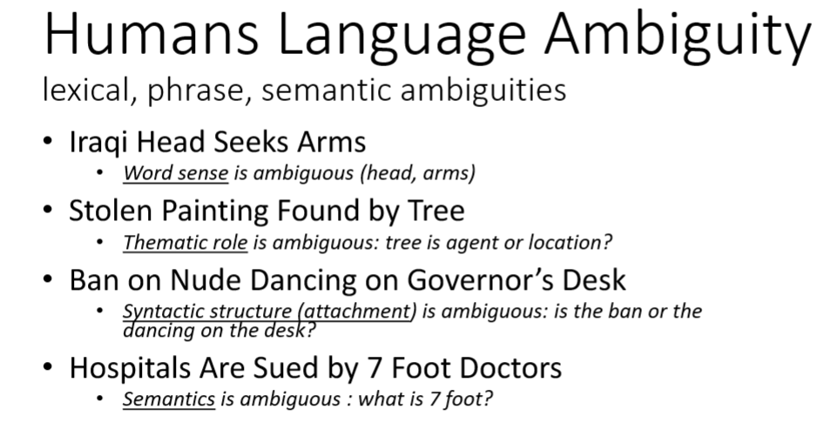

Why is NLP hard?

Slide 12
Why is NLP hard?
Language is subtle.
Similar the contexts may not guarantee
He arrived at the lecture
He chuckled at the lecture
He chuckled his way through the lecture
**He arrived his way through the lecture

Slide 13
Why is NLP hard?
Language is representation is unique
There is no known universal representation, parsing rules are flexible.
Language could be domain-specific e.g. legal, scientific texts
Meanings are context-dependent, world knowledge required for interpretation
There are so many languages, dialects and styles etc.

Slide 14
Common NLP Tasks
See an extended list of NLP tasks: https://nlpprogress.com/

Slide 15


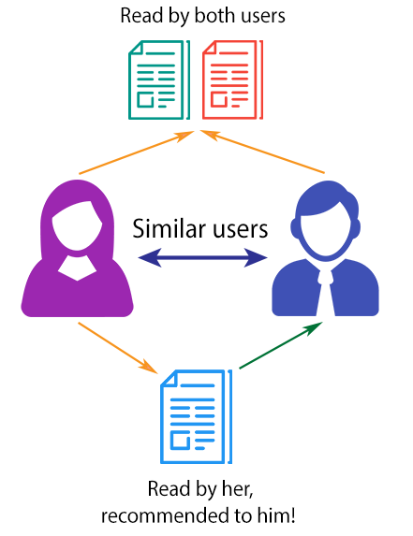



Application of NLP
Language processing
Web search engines
Text classification: sentiment, topic
Spam filtering etc
Machine translation
Question answering
Recommender Systems

Slide 16
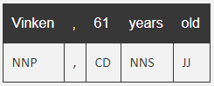
Part of Speech Tagging
One of the most fundamental tasks in NLP
A part of speech is a category of words with similar grammatical properties.
Common English parts of speech are noun, verb, adjective, adverb, pronoun, preposition, conjunction, etc.
It involved applying certain techniques (and statistics) to identify the part of speech of a word in context e.g. in a sentence
https://nlpprogress.com/english/part-of-speech_tagging.html

Slide 17
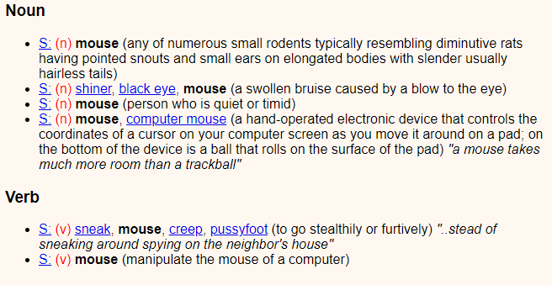
Word Sense Disambiguation
WSD associates words in context with the right entry in a sense inventory e.g. WordNet.
Example, mouse:
A mouse consists of an object held in one’s hand, with one or more buttons.
Assigns “mouse” with its electronic device sense (the 4th sense in the WordNet).
https://nlpprogress.com/english/word_sense_disambiguation.html

Slide 18
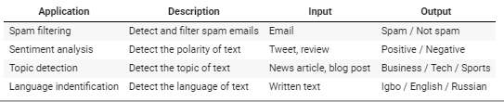
Text Classification
Text classification is a very common NLP task
It involves assigning an appropriate category to sentence or document e.g:
spam filtering, sentiment analysis, topic modelling, language id
https://nlpprogress.com/english/text_classification.html

Slide 19
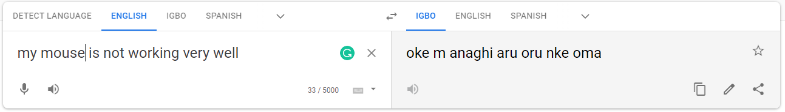
Machine Translation
Machine translation is the task of translating a sentence in a source language to a different target language
Common approaches:
Rule-based
Statistical machine translation (e.g. Phrase-Based approach)
Neural machine translation
https://en.wikipedia.org/wiki/Machine_translation

Slide 20
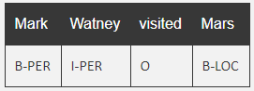
Named Entity Recognition
NER is the task of tagging entities in text with their corresponding type.
It is a useful subtask for information extraction
Approaches typically use BIO notation:
B-beginning, I-inside of entities.
O is used for non-entity tokens.
https://nlpprogress.com/english/named_entity_recognition.html

Slide 21
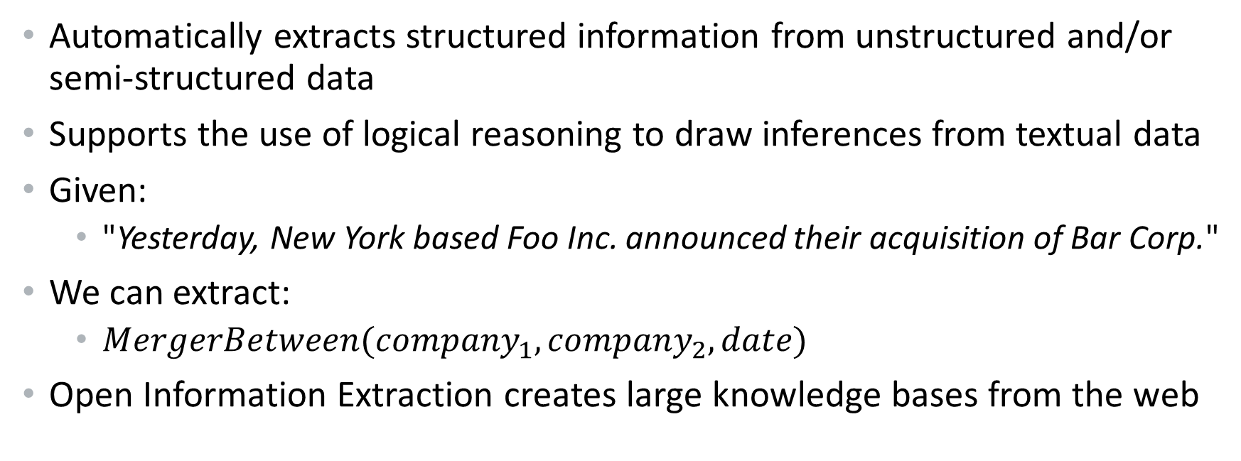
Information Extraction
Automatically extracts structured information from unstructured and/or semi-structured data
Supports the use of logical reasoning to draw inferences from textual data
Given:
"Yesterday, New York based Foo Inc. announced their acquisition of Bar Corp."
We can extract:
$MergerBetween({company}_{1},{company}_{2},date)$
Open Information Extraction creates large knowledge bases from the web

Slide 22



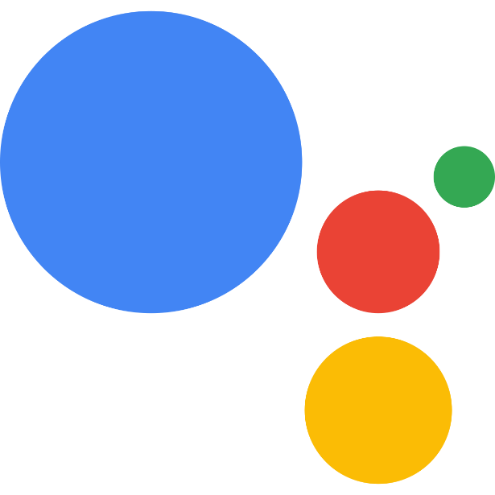
Spoken Language Systems
Enable the recognition and translation of spoken language into text
Automatic Speech Recognition
Text-to-Speech Synthesis
Dialogue systems
Examples:
Siri, Alexa, Cortana, Google Assistant
Google’s supported voices and language: https://cloud.google.com/text-to-speech/docs/voices

Slide 23
Machine Learning Overview
See an extended list of NLP tasks: https://nlpprogress.com/

Slide 24
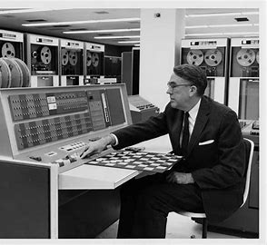
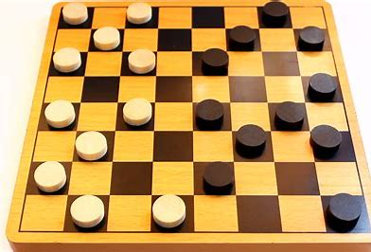
Machine Learning
Early definition of machine learning
“Field of study that gives computers the ability to learn without being explicitly programmed”
– Arthur Samuel (1959)
ML pioneer that built first “self-learning” program that played checkers by learning from experience
Inverted alpha-beta pruning widely used in decision tree searching
Notes:
Machine Learning is the study of computer algorithms that improve automatically through experience – Tom Mitchell
In machine learning, we convert things (data) into numbers and try to find patterns in the numbers using algorithms i.e. math and logic.
Machine Learning, in the simplest of terms, is teaching your machine about something. You collect data, clean the data,
create algorithms, teach the algorithm essential patterns from the data and then expect the algorithm to give you a helpful answer.

Slide 25

Machine Learning
Another popular definition:
“A computer is said to learn from experience E with respect to task T and some performance measure P, if its performance on T, as measured by P, improved with experience E”
– Tom Mitchell (1997)
Again, the key is learning from experience
Not explicitly programmed
Notes:
Machine Learning is the study of computer algorithms that improve automatically through experience – Tom Mitchell
In machine learning, we convert things (data) into numbers and try to find patterns in the numbers using algorithms i.e. math and logic.
Machine Learning, in the simplest of terms, is teaching your machine about something. You collect data, clean the data,
create algorithms, teach the algorithm essential patterns from the data and then expect the algorithm to give you a helpful answer.

Slide 26
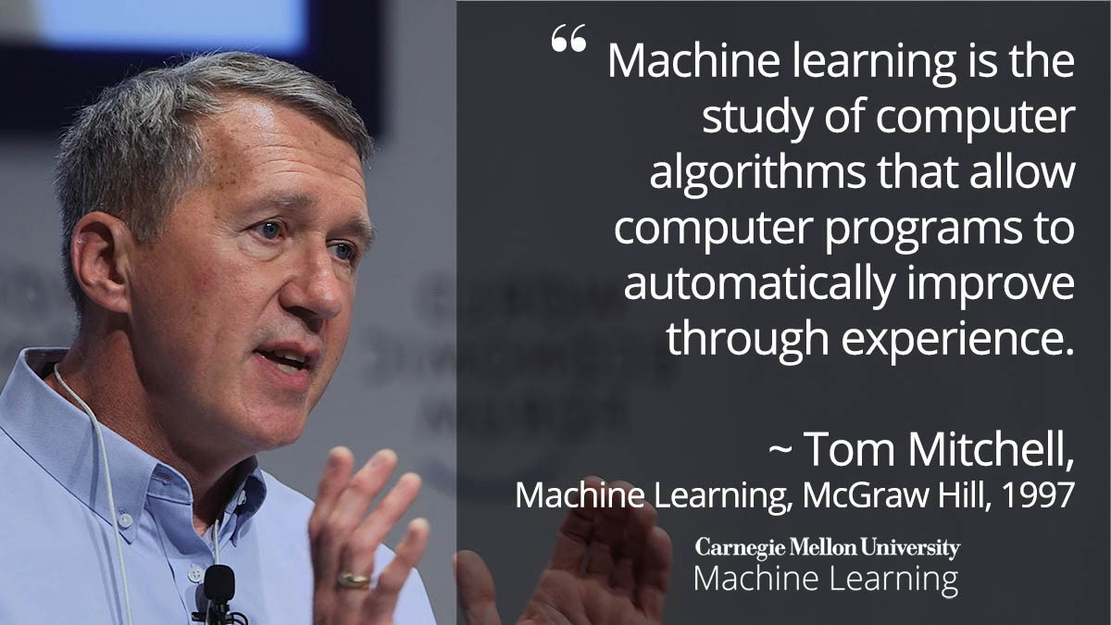
Machine Learning
Notes:
Machine Learning is the study of computer algorithms that improve automatically through experience – Tom Mitchell
In machine learning, we convert things (data) into numbers and try to find patterns in the numbers using algorithms i.e. math and logic.
Machine Learning, in the simplest of terms, is teaching your machine about something. You collect data, clean the data,
create algorithms, teach the algorithm essential patterns from the data and then expect the algorithm to give you a helpful answer.

Slide 27
Spam or not SPAM?
Given this definition:
A computer is said to learn from experience E with respect to task T and some performance measure P, if its performance on T, as measured by P, improved with experience E”
My email program watches me mark some emails as spam, and improves on filtering spams. What is the T, E and P in the setting?
Watching me label emails as spam
Classifying emails as spam or not spam
The fraction of emails correctly classified as spam or not
None of the above – this is not a machine learning problem

Slide 28
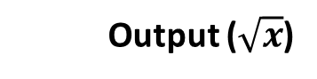
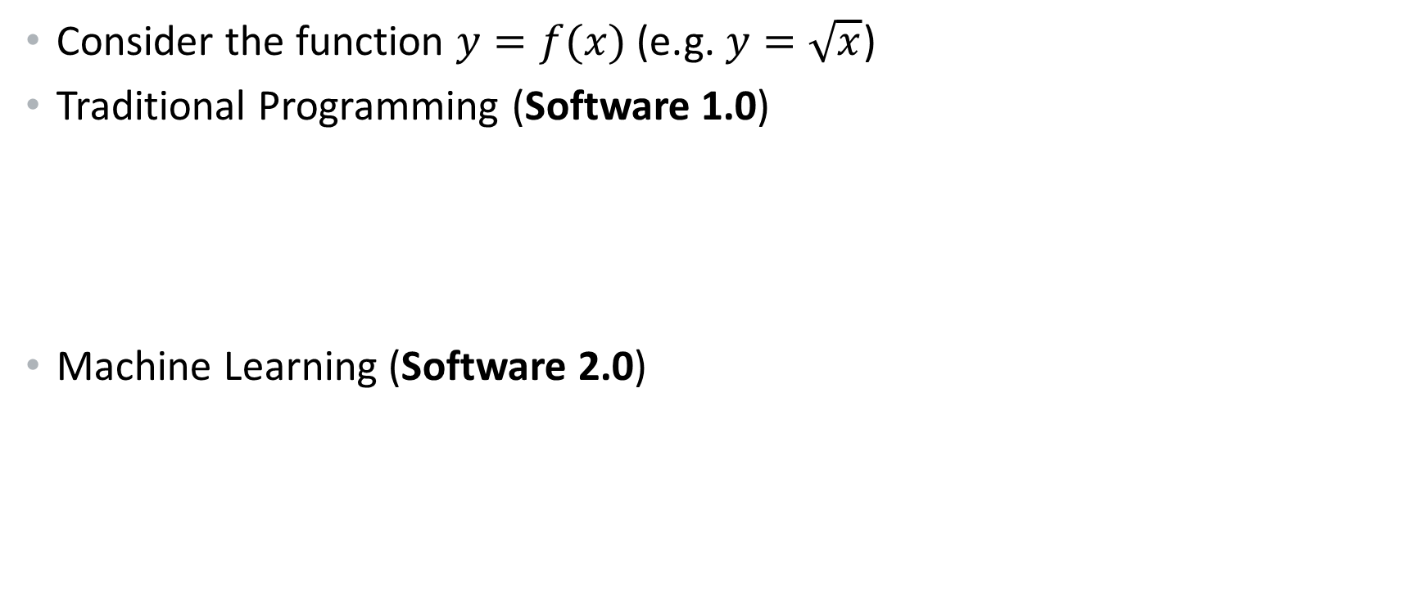
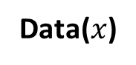
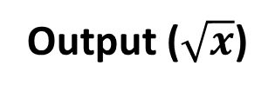
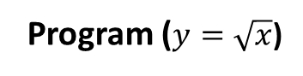
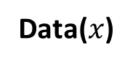
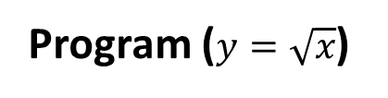
Software 2.0
Consider the function $y=f(x)$ (e.g. $y=\sqrt{x}$)
Traditional Programming (Software 1.0)
Machine Learning (Software 2.0)
Data($x$)
Computer
Program ($y=\sqrt{x}$)
Output ($\sqrt{x}$)
Data($x$)
Computer
Output ($\sqrt{x}$)
Program ($y=\sqrt{x}$)
Notes:
spam email classifier model is a basically a curve fitting by linear regression

Slide 29


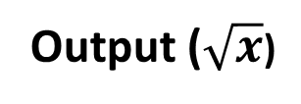
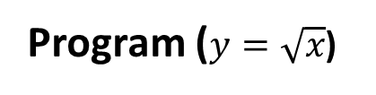
Software 2.0
Consider the function $y=f(x)$ (e.g. $y=\sqrt{x}$)
Traditional Programming (Software 1.0)
Machine Learning (Software 2.0)
Data($x$)
Computer
Program ($y=\sqrt{x}$)
Output ($\sqrt{x}$)
Data($x$)
Computer
Output ($\sqrt{x}$)
Program ($y=\sqrt{x}$)
Notes:
spam email classifier model is a basically a curve fitting by linear regression

Slide 30
How things are learned
Memorization
Accumulation of individual facts
Limited by
Time to observe facts
Memory to store facts
Declarative knowledge

Slide 31
How things are learned
Memorization
Accumulation of individual facts
Limited by
Time to observe facts
Memory to store facts
Generalization
Deduce new facts from old facts
Limited by accuracy of deduction process
Essentially a predictive activity
Assumes that the past predicts the future
Declarative knowledge
Better
Imperative knowledge

Slide 32
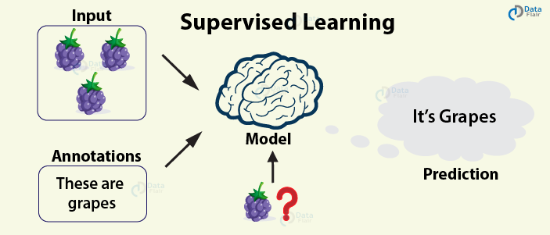
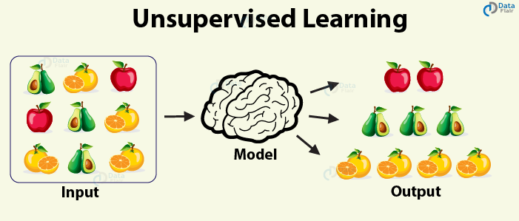
Types Machine Learning
Supervised
Classification
Regression
Unsupervised
Clustering
Association
Notes:
Supervised Learning is the process of making an algorithm to learn to map an input to a particular output.
This is achieved using the labelled datasets that you have collected. If the mapping is correct, the algorithm has successfully learned.
Else, you make the necessary changes to the algorithm so that it can learn correctly.
Supervised Learning algorithms can help make predictions for new unseen data that we obtain later in the future

Slide 33
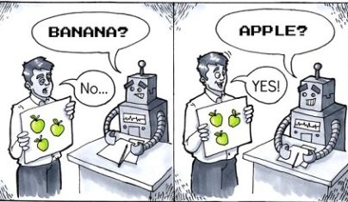
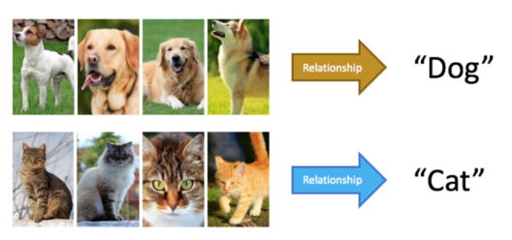
Supervised Learning
The algorithm learns to map an input to a particular output.
Instances of data are presented along with their correctly labelled output
Similar to a teacher-student scenario
The algorithm learns from experience to predict new unseen data
Two broad categories:
Regression
Classification
Notes:
Supervised Learning is the process of making an algorithm to learn to map an input to a particular output.
This is achieved using the labelled datasets that you have collected. If the mapping is correct, the algorithm has successfully learned.
Else, you make the necessary changes to the algorithm so that it can learn correctly.
Supervised Learning algorithms can help make predictions for new unseen data that we obtain later in the future

Slide 34
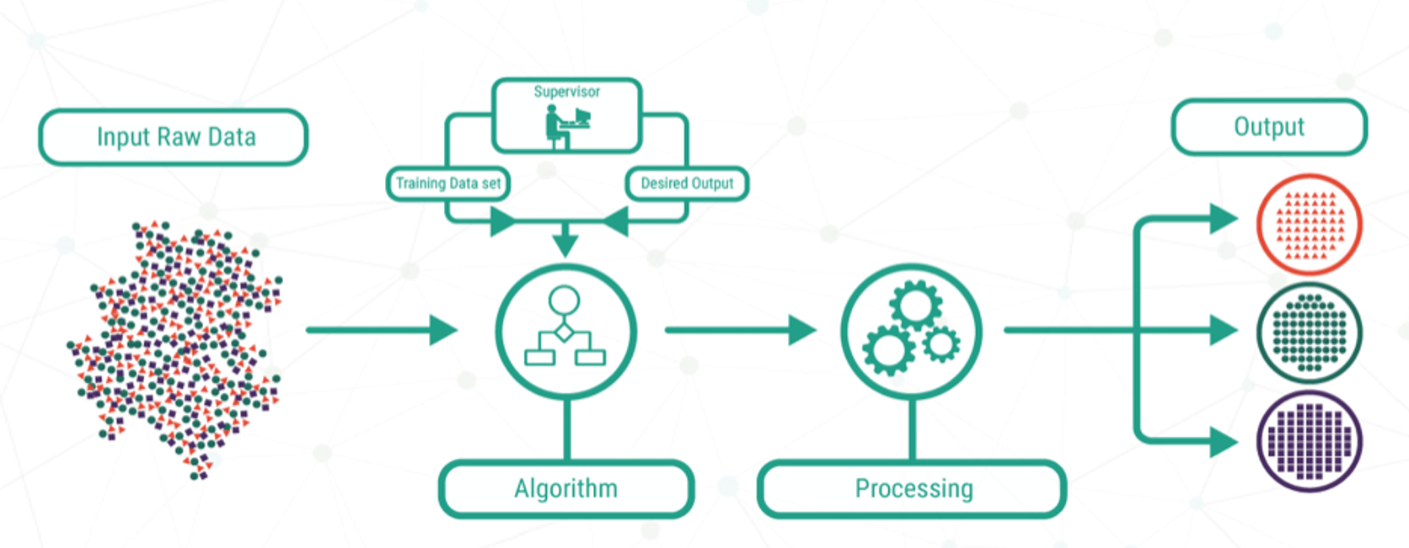
Supervised Learning
Input labelled data
Training process
Trained Model
Output
Algorithms
New unseen data

Slide 35
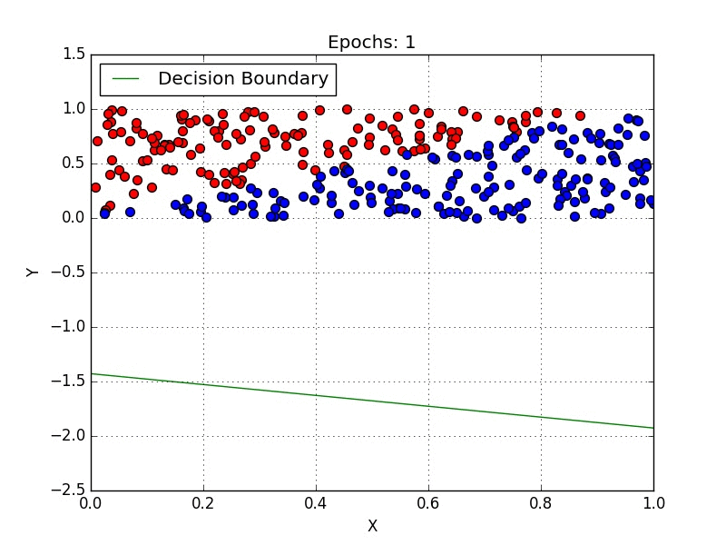

Classification
Classification:
Also learns from labelled data (supervised)
Predicts a category or a class
Cats|Dogs, Spam|Ham, Cancer|Not Cancer
Attempts to separate the data into specific categories (or classes or labels)
Notes:
Supervised Learning is the process of making an algorithm to learn to map an input to a particular output.
This is achieved using the labelled datasets that you have collected. If the mapping is correct, the algorithm has successfully learned.
Else, you make the necessary changes to the algorithm so that it can learn correctly.
Supervised Learning algorithms can help make predictions for new unseen data that we obtain later in the future

Slide 36
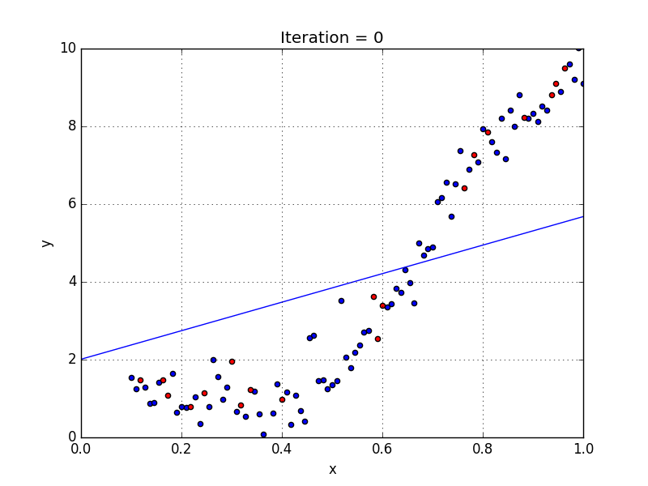
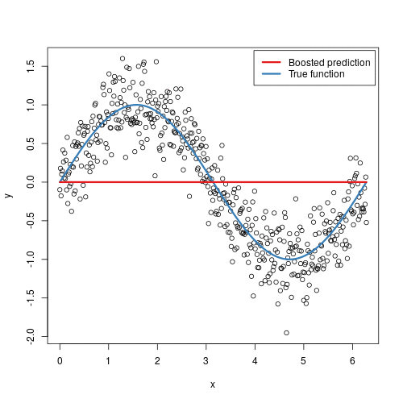
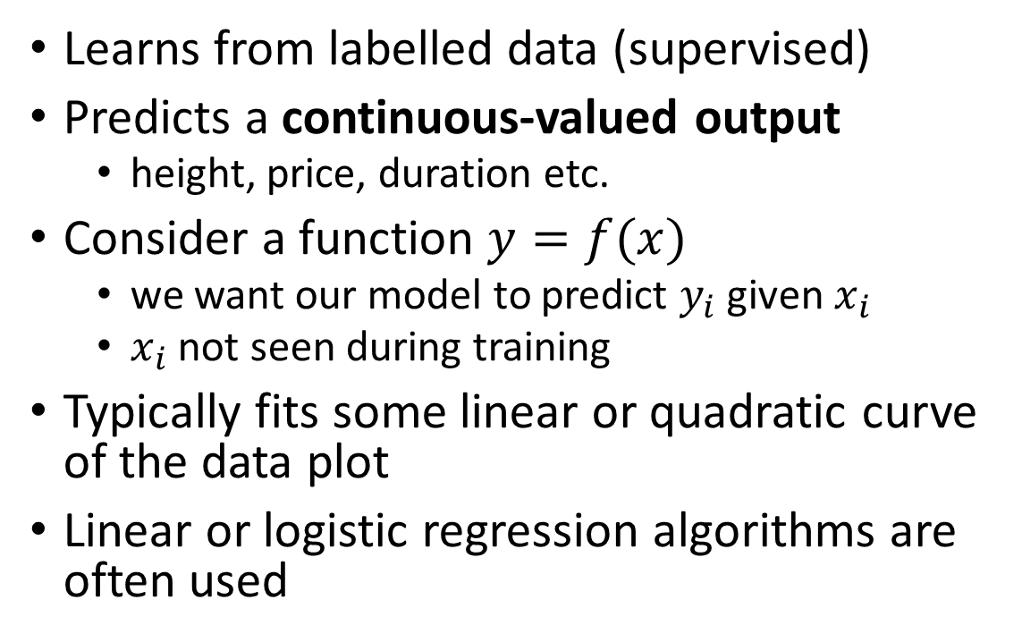
Regression
Learns from labelled data (supervised)
Predicts a continuous-valued output
height, price, duration etc.
Consider a function $y=f(x)$
we want our model to predict $y_{i}$ given $x_{i}$
$x_{i}$ not seen during training
Typically fits some linear or quadratic curve of the data plot
Linear or logistic regression algorithms are often used
Notes:
Supervised Learning is the process of making an algorithm to learn to map an input to a particular output.
This is achieved using the labelled datasets that you have collected. If the mapping is correct, the algorithm has successfully learned.
Else, you make the necessary changes to the algorithm so that it can learn correctly.
Supervised Learning algorithms can help make predictions for new unseen data that we obtain later in the future

Slide 37
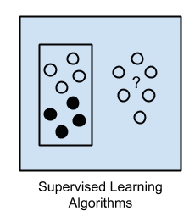
Supervised Learning Algorithms
Input data = training data
with labels e.g. spam/ham or stock price at t
In training
the model makes a prediction and is corrected if the prediction is wrong
Training process continues until a desired accuracy is achieved
Problem types: Classification and Regression
Algorithms:
Logistic Regression
Back Propagation Neural Network.
Notes:
There are so many learning algorithms. Here we look at some of the commonly applied ones for the learning methods we have discussed
1. Supervised Learning
Input data is called training data and has a known label or result such as spam/not-spam or a stock price at a time.
A model is prepared through a training process in which it is required to make predictions and is corrected when those predictions are wrong.
The training process continues until the model achieves a desired level of accuracy on the training data.
Example problems are classification and regression.
Example algorithms include: Logistic Regression and the Back Propagation Neural Network.

Slide 38
Classification vs Regression
If we wish to learn models to address the following
Predict how many students will enrol in this module in the next 3 years given the past enrolment data
Predict whether a student will pass the module given previous years records
How should we proceed
Both are regression problems
Both are classification problems
Problem 1 is regression while Problem 2 is classification
Problem 2 is regression while Problem 1 is classification

Slide 39
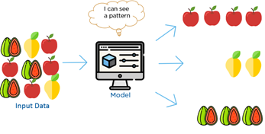
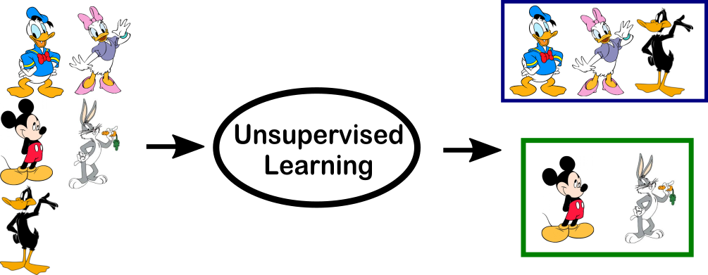
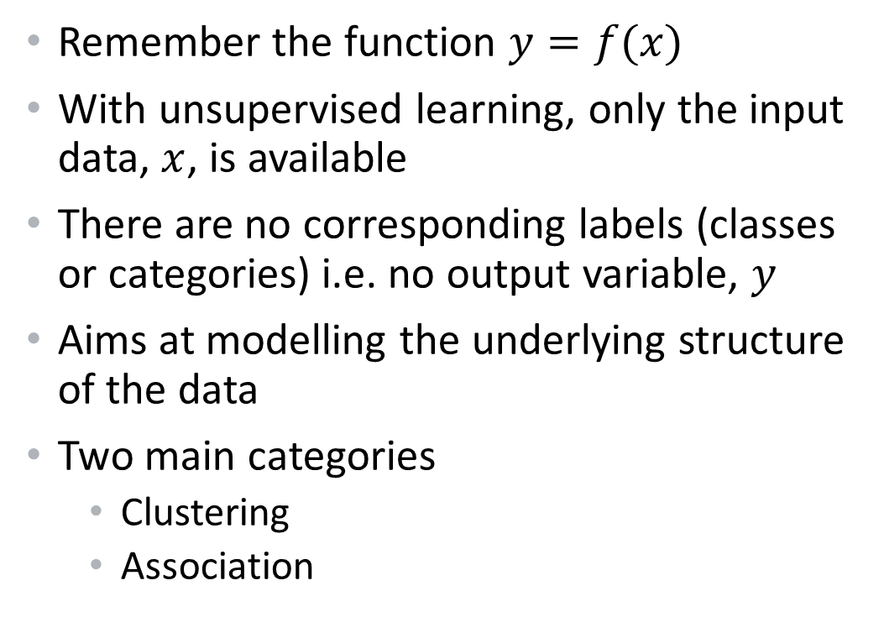
Unsupervised Learning
Remember the function $y=f(x)$
With unsupervised learning, only the input data, $x$, is available
There are no corresponding labels (classes or categories) i.e. no output variable, $y$
Aims at modelling the underlying structure of the data
Two main categories
Clustering
Association
Notes:
Unsupervised learning is where you only have input data (X) and no corresponding output variables.
The goal for unsupervised learning is to model the underlying structure or distribution in the data in order to learn more about the data.
These are called unsupervised learning because unlike supervised learning above there is no correct answers and there is no teacher.
Algorithms are left to their own devises to discover and present the interesting structure(s) in the data.
Unsupervised learning problems can be further grouped into clustering and association problems.
Clustering: A clustering problem is where you want to discover the inherent groupings in the data, such as grouping customers by purchasing behaviour.
Association: An association rule learning problem is where you want to discover rules that describe large portions of your data, such as people that buy X also tend to buy Y

Slide 40
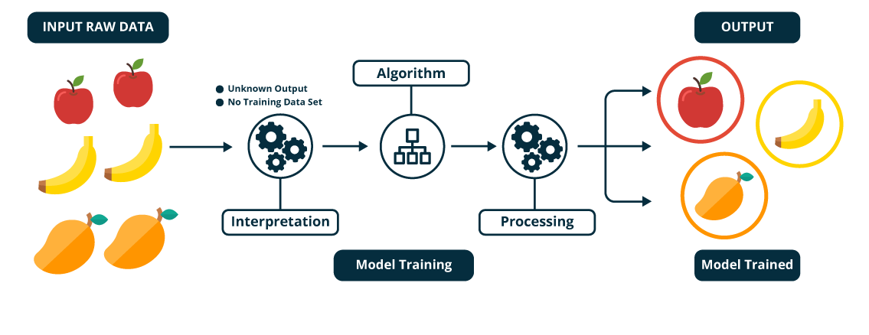

Unsupervised Learning
No labels
Notes:
Unsupervised learning is where you only have input data (X) and no corresponding output variables.
The goal for unsupervised learning is to model the underlying structure or distribution in the data in order to learn more about the data.
These are called unsupervised learning because unlike supervised learning above there is no correct answers and there is no teacher.
Algorithms are left to their own devises to discover and present the interesting structure(s) in the data.
Unsupervised learning problems can be further grouped into clustering and association problems.
Association: An association rule learning problem is where you want to discover rules that describe large portions of your data, such as people that buy X also tend to buy Y

Slide 41
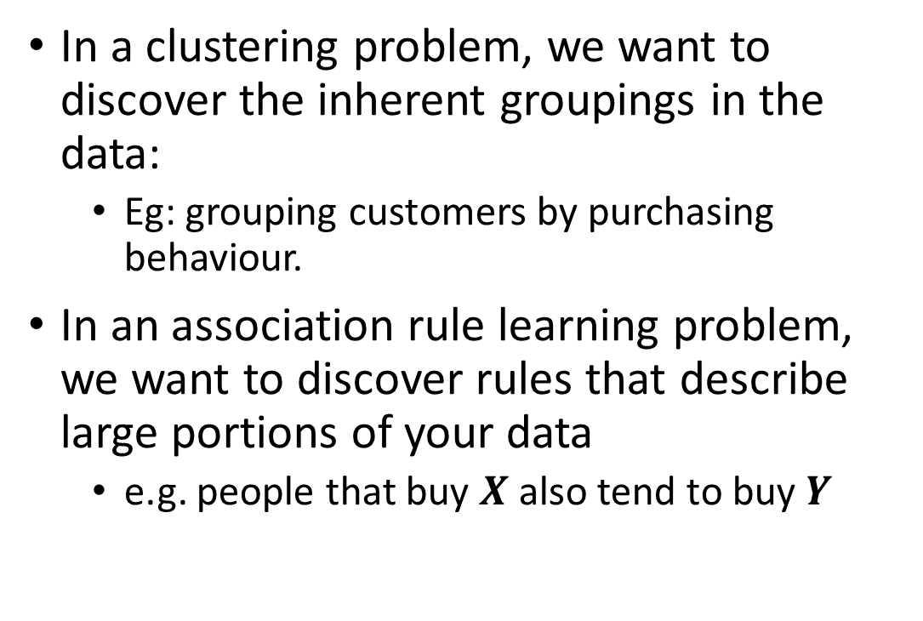
Clustering and Association
In a clustering problem, we want to discover the inherent groupings in the data:
Eg: grouping customers by purchasing behaviour.
In an association rule learning problem, we want to discover rules that describe large portions of your data
e.g. people that buy $X$ also tend to buy $Y$
Notes:
Clustering: A clustering problem is where you want to discover the inherent groupings in the data, such as grouping customers by purchasing behaviour.

Slide 42
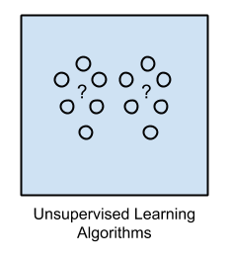
Unsupervised Learning Algorithms
Input data in not labelled
Output not known
In training
Deduces structures present in the input data
Extracting general rules, reducing redundancy or organise data by similarity
Problem types: clustering, dimensionality reduction and association rule learning
Algorithms:
K-Means algorithm
Apriori algorithm.
Notes:
Input data is not labelled and does not have a known result.
A model is prepared by deducing structures present in the input data. This may be to extract general rules. It may be through a mathematical process to systematically reduce redundancy, or it may be to organize data by similarity.
Example problems are clustering, dimensionality reduction and association rule learning.
Example algorithms include: the Apriori algorithm and K-Means

Slide 43
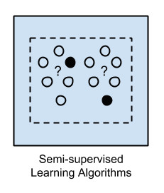
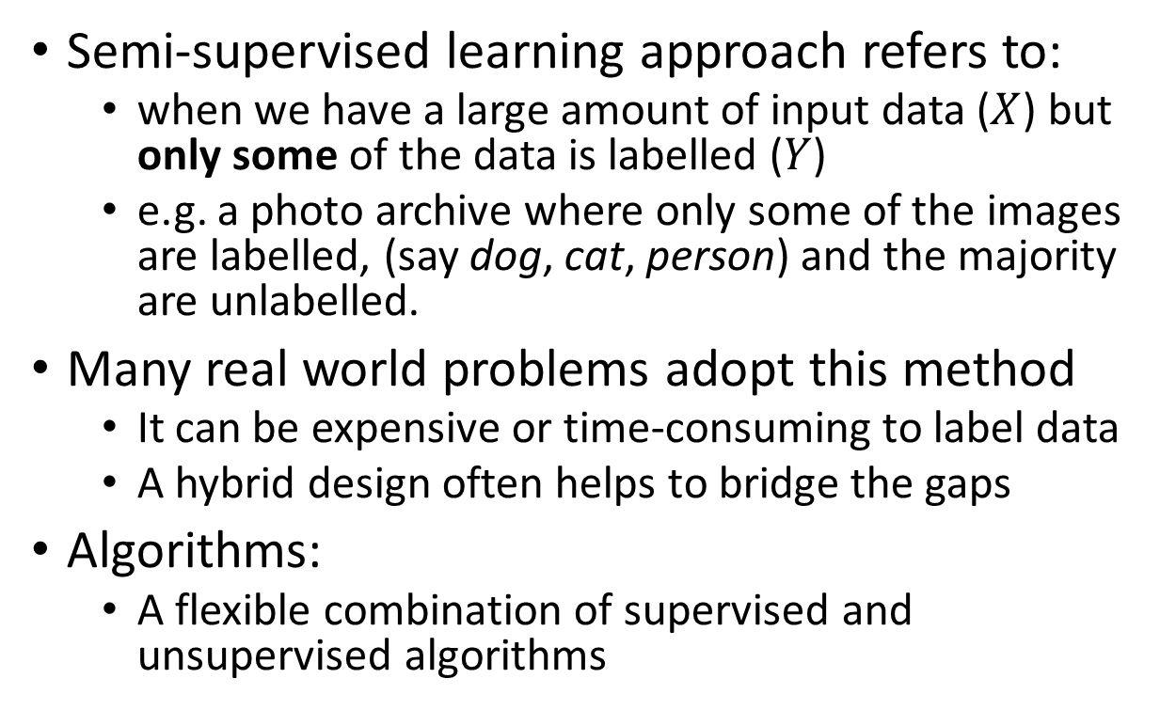
Semi-supervised Learning
Semi-supervised learning approach refers to:
when we have a large amount of input data ($X$) but only some of the data is labelled ($Y$)
e.g. a photo archive where only some of the images are labelled, (say dog, cat, person) and the majority are unlabelled.
Many real world problems adopt this method
It can be expensive or time-consuming to label data
A hybrid design often helps to bridge the gaps
Algorithms:
A flexible combination of supervised and unsupervised algorithms
Notes:
Problems where you have a large amount of input data (X) and only some of the data is labeled (Y) are called semi-supervised learning problems.
These problems sit in between both supervised and unsupervised learning.
A good example is a photo archive where only some of the images are labeled, (e.g. dog, cat, person) and the majority are unlabeled.
Many real world machine learning problems fall into this area. This is because it can be expensive or time-consuming to label data as it may require access to domain experts. Whereas unlabeled data is cheap and easy to collect and store.
You can use unsupervised learning techniques to discover and learn the structure in the input variables.
You can also use supervised learning techniques to make best guess predictions for the unlabeled data, feed that data back into the supervised learning algorithm as training data and use the model to make predictions on new unseen data.

Slide 44
AI and Machine Learning
AI systems were mostly rule-based
i.e. depended on hand-crafted rules
Machine learning drives AI
Learning algorithms create a logical mapping from data to output
Deep learning:
a subset of ML with additional layers to learn deeper representations data
Artificial Intelligence
Machine Learning
Deep Learning

Slide 45



10 minutes break & Question Time Next: Machine Learning for NLP

Slide 46
Machine Learning for NLP
Machine Learning RoadMap YouTube

Slide 47
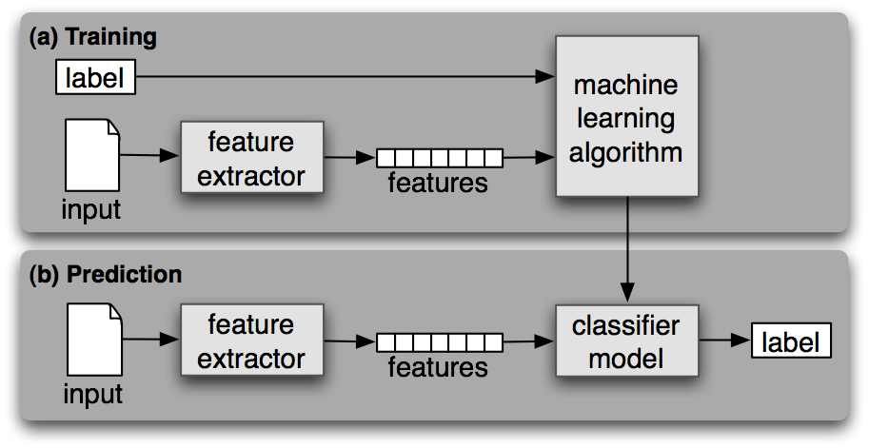
Supervised ML for Text

Slide 48
Supervised ML for Text
Key components of the supervised ML include
input (training) data (instances)
Correct labels
Feature extractor
Machine learning algorithm
Classifier model

Slide 49
Supervised ML for Text
Key components of the supervised ML include
input (training) data (instances)
Correct labels
Feature extractor
Machine learning algorithm
Classifier model

Slide 50
Feature Extraction
Features are the key ingredients for creating data instances for training machine learning models
Feature extraction in NLP involves detecting patterns in text that can help in building an accurate model.
POS-tagging: Words ending in -ed tend to be past tense verbs.
Document classification: Frequent use of will is indicative of news text

Slide 51
Feature Extraction
A feature extractor is a function that converts each input value to a feature set.
Choosing simple features often gives good results but careful crafting the features can improve the result significantly
Wrong features could lead to poor performance.
Too many features could lead to overfitting.

Slide 52
What’s in a name?
download
>>> import nltk >>> nltk.download()
The NLTK data contains the Name corpus, a collection of about 8k male and female names. Below are 10 of the names
Could you tell what gender each of the names is?
Name | M/F | Name | M/F | Name | M/F | Name | M/F
Abbey |  | Eddie |  | Jaime |  | Nickie
Barrie |  | Frank |  | Kellen |  | Ollie
Cary |  | Gabriel |  | Lanny |  | Quentin
Daniel |  | Haley |  | Maddie |  | Regan

Slide 53
What’s in a name?
download
>>> import nltk >>> nltk.download()
The NLTK data contains the Name corpus, a collection of about 8k male and female names. Below are 10 of the names
Could you tell what gender each of the names is?
Answer: Each name can be both male or female?
Name | M/F | Name | M/F | Name | M/F | Name | M/F
Abbey |  | Eddie |  | Jaime |  | Nickie
Barrie |  | Frank |  | Kellen |  | Ollie
Cary |  | Gabriel |  | Lanny |  | Quentin
Daniel |  | Haley |  | Maddie |  | Regan

Slide 54
Gender Identification
How do we train a model that can make a good guess of the gender of a name?

Slide 55
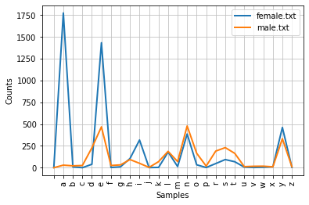
Gender Identification
How do we train a model that can make a good guess of the gender of a name?

Slide 56
Gender Identification
How do we train a model that can make a good guess of the gender of a name?
Female names more likely to end in a, e and I
Male names more likely to end in k, o, r, s and t
Can we extract this feature for training the classifier?

Slide 57
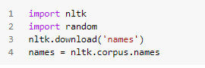
Demo – Importing the names corpus
We can import `nltk` and download the `names` corpus

Slide 58
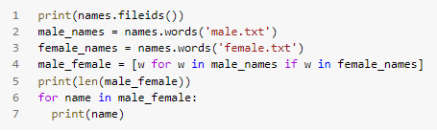
Demo – Names in both lists
We can also look at the names in both lists

Slide 59
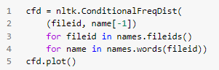
Demo – Distribution of last letters
We can plot the distribution of last names

Slide 60
Demo – Distribution of last letters
We can plot the distribution of last names

Slide 61
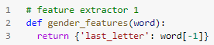
Demo – Create Feature Extractors (1)
We can create the feature extractor function get_features()

Slide 62
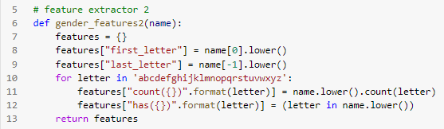
Demo – Create Feature Extractors (2)
We can create the feature extractor function get_features2()

Slide 63

Demo – Create Feature Extractors (3)
We can create the feature extractor function get_features3()

Slide 64

Demo – Building the Training Data
We can combine and shuffle the list to build the training data

Slide 65

Demo – Train:Dev:Test Split
We need to split our data into the training, development and testing sets

Slide 66

Demo – Train:Dev:Test Split
We need to split our data into the training, development and testing sets

Slide 67

Demo – Extracting Features from Data
We need to apply the feature extractor to each of the data splits
We also have gender_features2() and gender_features3()

Slide 68

Demo – Training and Testing
We train the classifier with the train_set using the nltk.NaiveBayesClassifier.train() function
We also test the classifier on the devtest_set

Slide 69
Online Demo
You can explore and extend these concepts on the Colab Jupyter Notebook below:
https://github.com/IgnatiusEzeani/NLP-Lecture/blob/main/Week_18_Lecture_Demo.ipynb

Slide 70
Coming next…
Flexible Labs (Wednesday and Thursday):
Other ML text classification tasks
Support for course work
Week 19 Lectures
More complex feature extraction from texts
Deep Neural Networks for Text Processing
Automatic feature extraction and model training with Neural Networks

Slide 71
Thank you for attending, any questions?

